Slide 1
Data Storytelling & Statistical Validation
Subtitle:
Internship Project – Sales Data Analysis

Slide 2
Objective
To analyze overall sales performance across different time periods and product categories in order to understand revenue behavior and growth patterns.
To identify key revenue drivers, including top-selling products and high-performing categories, that contribute the most to total sales.
To support data-driven business decisions by transforming raw sales data into meaningful insights using analysis and visualization techniques.
Analyzing monthly sales trends and seasonal patterns

Slide 3
Analysis Performed
Cleaned and preprocessed sales data using Python (Pandas, NumPy)
Conducted Exploratory Data Analysis (EDA) to identify patterns and outliers
Analyzed sales performance by product category and time period
Built interactive dashboards using Power BI for dynamic analysis
Evaluated monthly revenue trends to identify seasonal variations

Slide 4
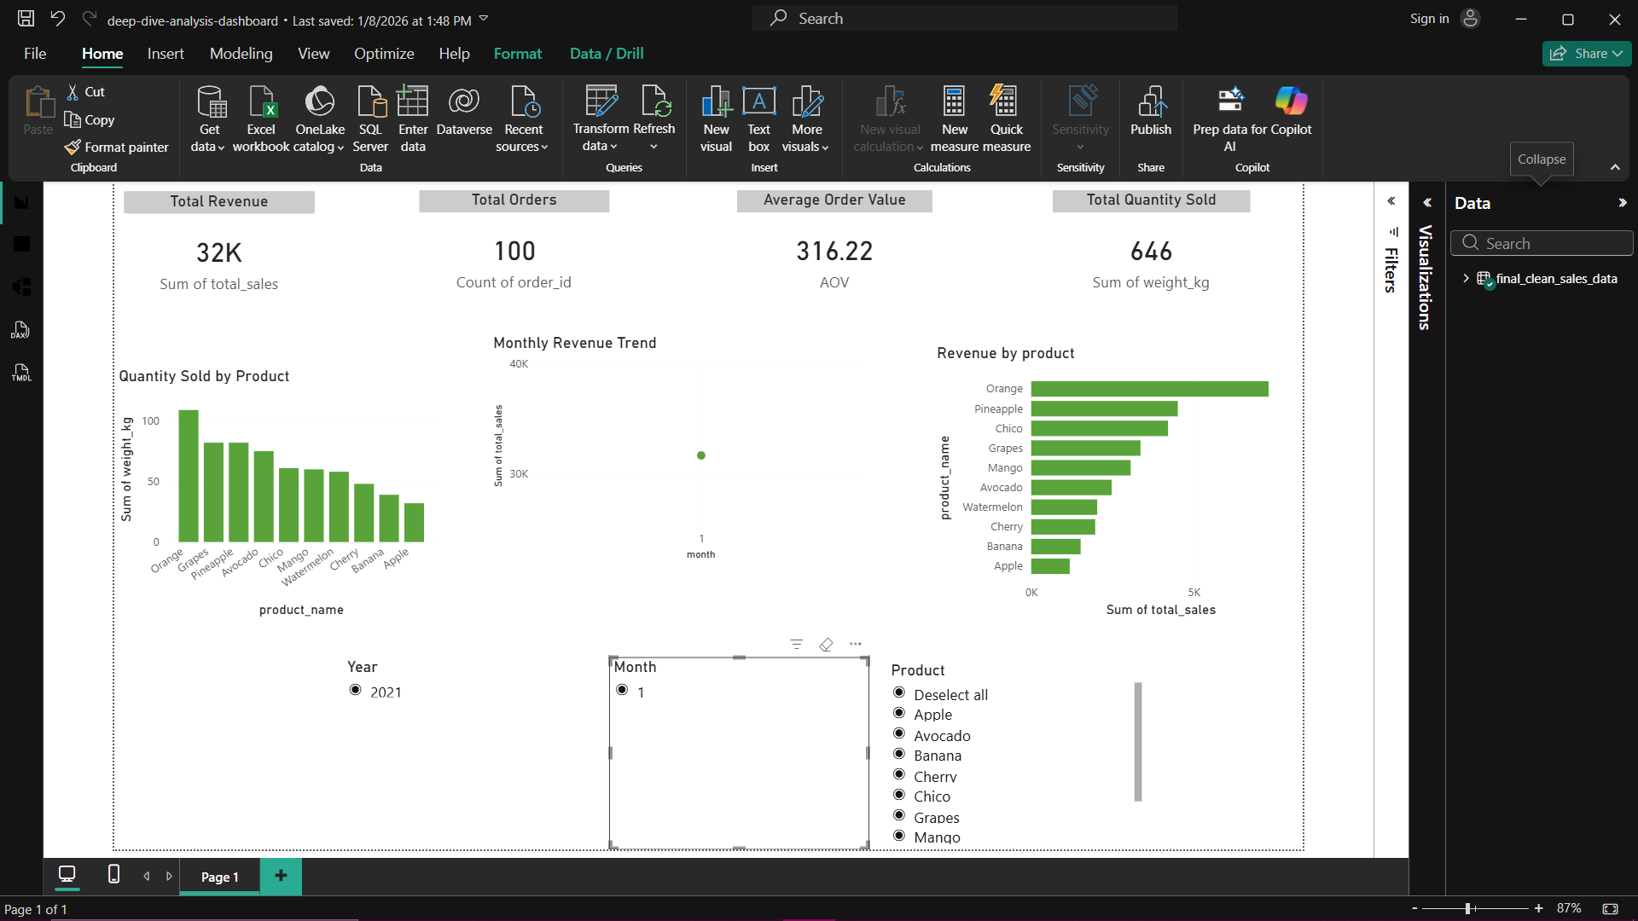
Key Insights
Top products contribute maximum revenue A small group of products accounts for a significant portion of total revenue, indicating that business performance is strongly driven by a few high-value items.
Monthly revenue shows seasonal trends Revenue varies across months, highlighting seasonal patterns with peak and low sales periods that can be leveraged for planning promotions and inventory.
Quantity sold does not always mean higher revenue Some products sell in large quantities but generate lower revenue due to lower pricing.

Slide 5
Business Recommendation
Promote high-revenue products Focus marketing campaigns and promotional efforts on products that contribute the most to revenue in order to maximize return on marketing investment.
Review pricing for low-revenue products Re-evaluate pricing strategies for products that sell in high quantities but generate lower revenue, and consider price optimization or bundling to improve profitability.
Use dashboards for continuous monitoring Leverage interactive Power BI dashboards to regularly track sales performance, monitor KPIs, and enable quick, data-driven business decisions

Slide 6
Conclusion
Data storytelling helps convert numbers into decisions By combining data analysis with clear narratives, complex numerical information is transformed into actionable business insights that support informed decision-making.
Dashboards enable faster business insights Interactive dashboards provide real-time visibility into key performance metrics, allowing stakeholders to quickly identify trends, issues, and opportunities.
Statistical validation adds confidence to findings Using statistical measures and well-defined KPIs ensures that insights are reliable, accurate, and supported by data, increasing trust in analytical outcomes.

Slide 7
Thank You

